Slide 1








IAS Tunisia Digital Sustainability Challenge
BioTrace
IEEE ISSATM SB

Slide 2



INTRODUCTION
REVOLUTIONIZING AGRICULTURE FOR SUSTAINABILITY IS URGENT IN THE FACE OF CLIMATE CHANGE AND A GROWING POPULATION. ADOPTING ADVANCED TECHNOLOGIES, PROMOTING REGENERATIVE PRACTICES, AND FOSTERING GLOBAL COOPERATION ARE ESSENTIAL STEPS. THIS TRANSFORMATION ISN'T JUST A GOAL—IT'S A CRUCIAL INITIATIVE FOR SECURING FOOD SOURCES, MINIMIZING ENVIRONMENTAL HARM, AND SAFEGUARDING THE FUTURE.

Slide 3



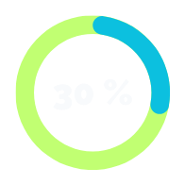


Problematic
CO2 levels
21st Century Sustainability Challenges :
Inefficient Land Management:
50%
Increase surge in global energy consumption over the last decade
Agricultural land grappling with suboptimal resource utilization
parts per million (ppm)

Slide 4
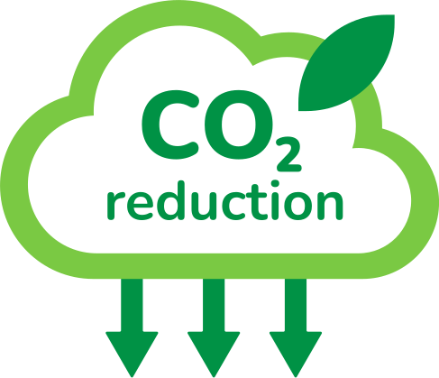

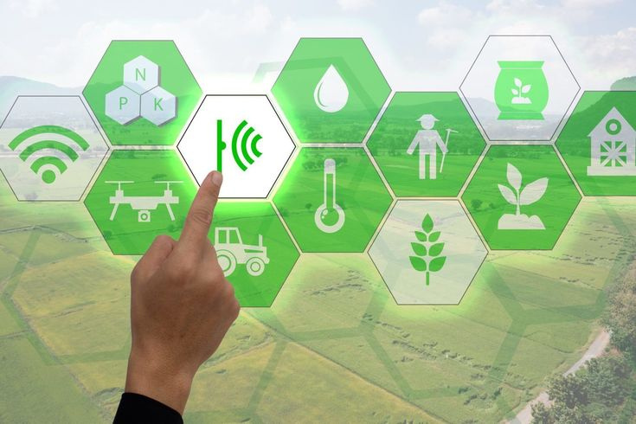
Solution
OUR PROPOSAL IS BASED ON AN INTEGRATED APPROACH THAT LEVERAGES BLOCKCHAIN, IOT, AND WEB 3 TO REDUCE CO2 EMISSIONS BY OPTIMIZING LAND USE PRACTICES.

Slide 5



Feasibility
Phased Implementation: Pilot programs, collaboration with agricultural communities, and global scaling
Resource Requirements: Skilled agritech professionals, investment in IoT, blockchain, and Web 3.0.
Measuring Success: Monitoring KPIs—carbon footprint reduction, resource efficiency, and user adoption rates.

Slide 6


Sustainable Theme:
Circular Economy
Sustainable Agriculture
We promotes a closed-loop system using blockchain, minimizing waste and optimizing resource use.
Sustainable agricultural practices for long-term environmental health

Slide 7

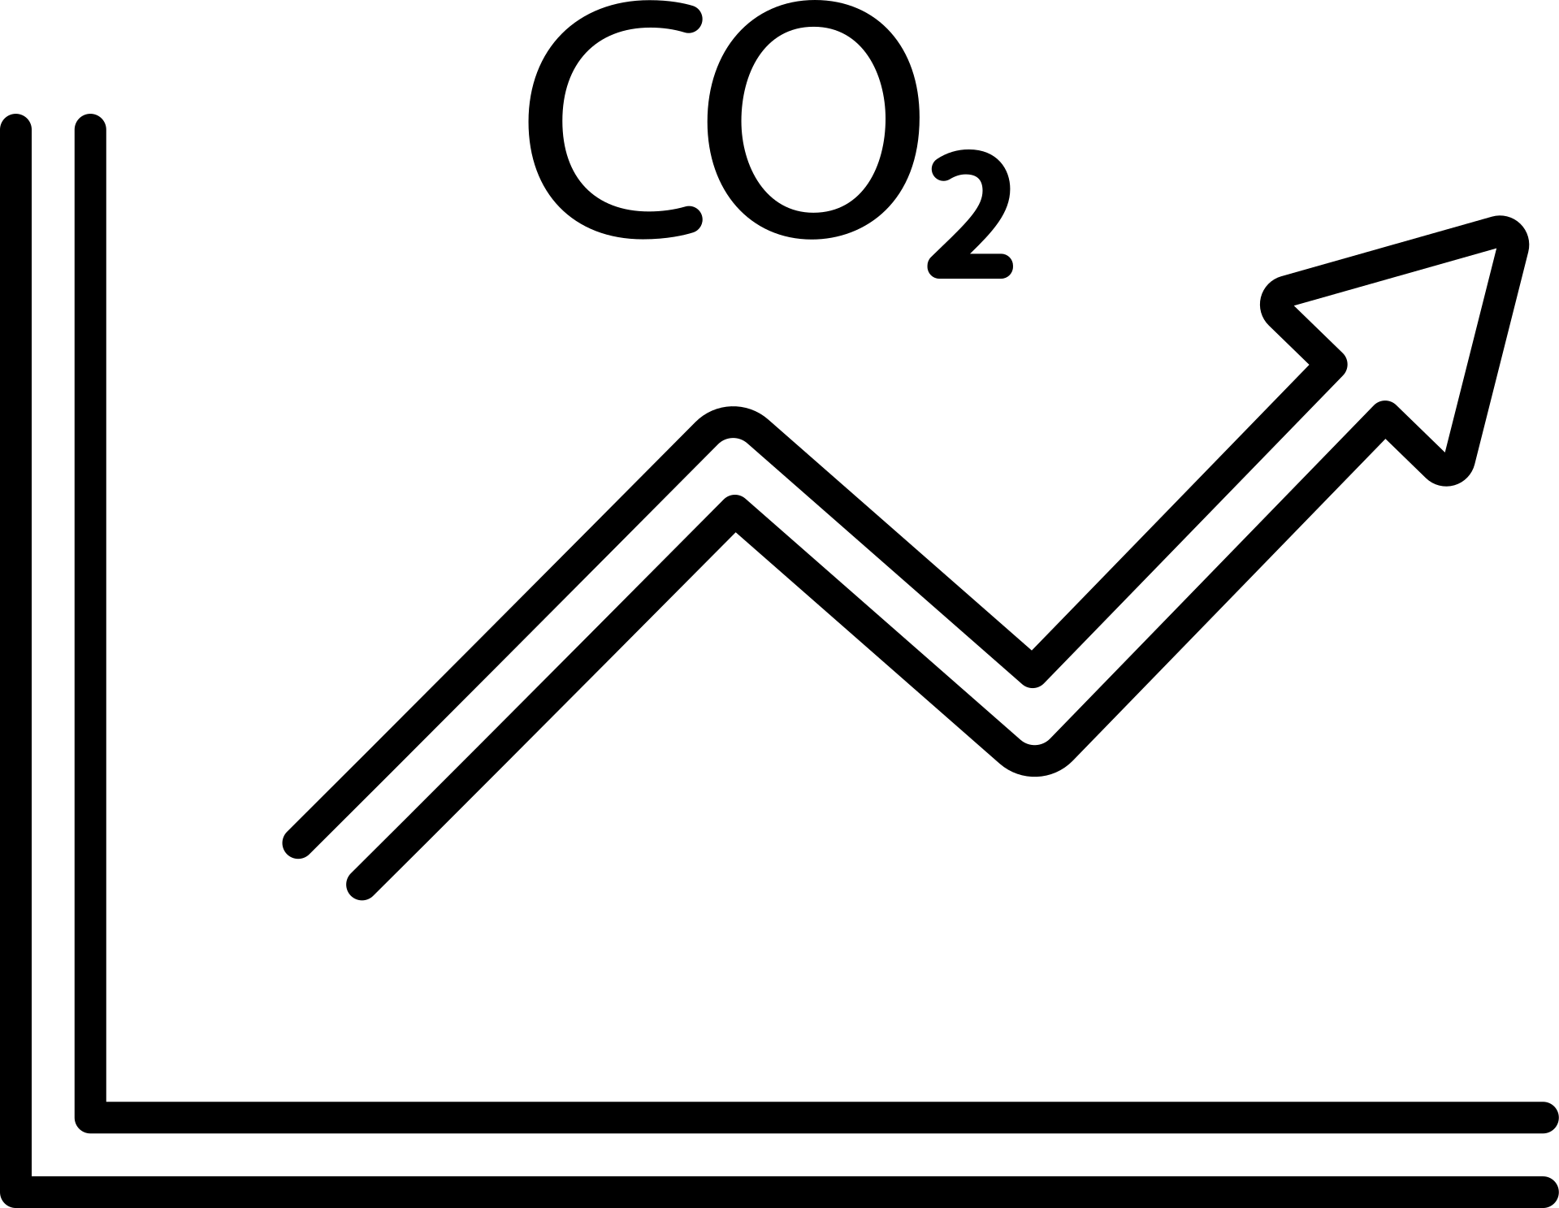

Project Scope
Objective:
To revolutionize agriculture using an integrated approach
Scope:
Optimizing land-use practices for increased carbon storage.
Implementing IoT, blockchain, and Web 3.0 for sustainable solutions.
Global application with a focus on diverse agricultural landscapes.

Slide 8

Methodology
Approach:
Develop IoT infrastructure for real-time data on soil and plant conditions.
Integrate blockchain for transparent supply chain and traceability.
Implement Web 3.0 applications for user-friendly experiences.
Implementation:
Phased approach, starting with pilot programs and scaling globally.
Collaboration with agricultural communities and technology partners.

Slide 9



Impact
Carbon Footprint Reduction:
IoT-driven precision farming minimizes energy use, significantly reducing carbon footprint
Resource Efficiency:
Blockchain ensures a transparent supply chain, reducing waste and enhancing resource efficiency.
Sustainable Agriculture:
Equipping farmers with IoT tools fosters sustainable practices for long-term environmental health.

Slide 10
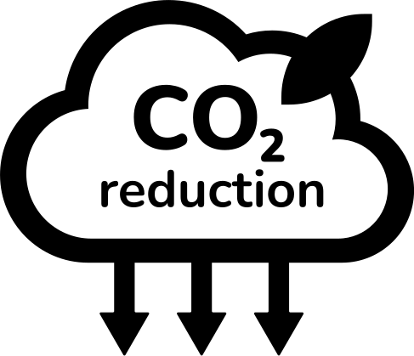
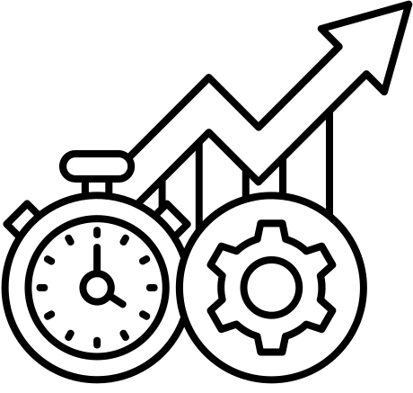


Sustainability Plan:
Carbon Footprint Reduction
Resource Efficiency
Implement IoT for precision farming to optimize energy use
(with Annual tracking )
Use blockchain for transparent supply chain, minimizing waste
(Continuous monitoring and enhancement)
Sustainable Agriculture Practices
User Education and Engagement
Provide farmers with IoT-enabled tools for precision agriculture
(Evaluate adoption rates and impact on soil )
Conduct regular training on sustainable practices via Web 3.0 platforms.

Slide 11

Value proposition
Innovating agriculture sustainably.
Reducing carbon footprint with optimized practices.
Blockchain transparency, enhanced user experience with Web 3.0.

Slide 12
Bussiness Model Canva
Partners :
Agricultural Equipment Suppliers
Blockchain Technology Providers
Environmental Research Institutions
Key activities :
Research and Development
Collaboration with Environmental Agencies
Monitoring and Support for Users
Value proposition :
Carbon Footprint Reduction
Transparent Supply Chain
Enhanced Resource Efficiency
Improved User Experience
Customer relationship:
Training and Updates
Community Engagement through Web 3.0
Customer segment :
Sustainable Agriculture Enterprises
Small and Medium-Sized Farms
Environmental Agencies and NGOs
Channels:
Direct Sales and Partnerships
Online Platforms and Marketplaces
Key resources :
IoT Sensors
Blockchain
Skilled Agritech
Cost structure:
Research and Development
IoT Device Manufacturing
Marketing and Sales
Customer Support and Training
Revenue structure:
Sales of IoT Devices and Sensors
Subscription-based Access to Blockchain Platform
Consultancy Services for Implementation

Slide 13











IOT architecture
Multi-Parameter Weather Sensor
Cup anemometer wind
CO2 Transmitter
Integrated Soil Monitoring Sensor
ESP 32 CARD
Database
(cloud)
Mobile App
Soil and Wastewater pH Sensor
Tipping Bucket Rainfall
Rechargeable Lithium Ion Batteries

Slide 14
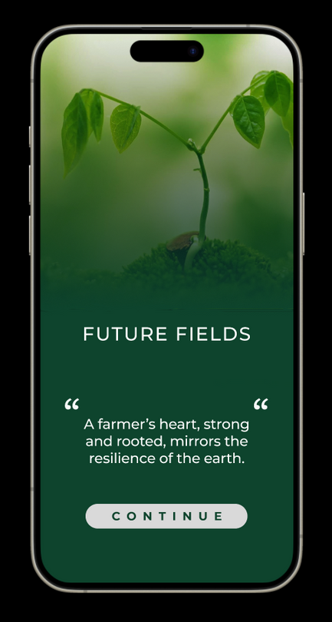
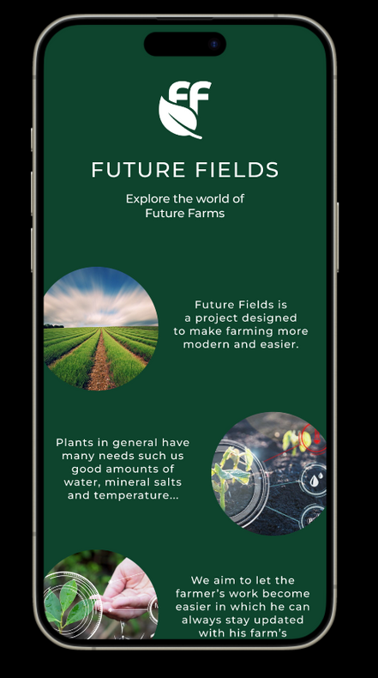
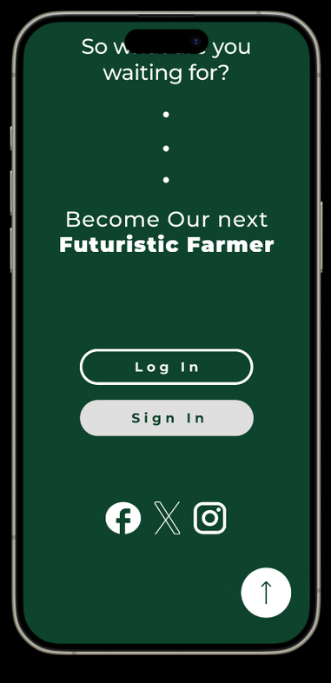
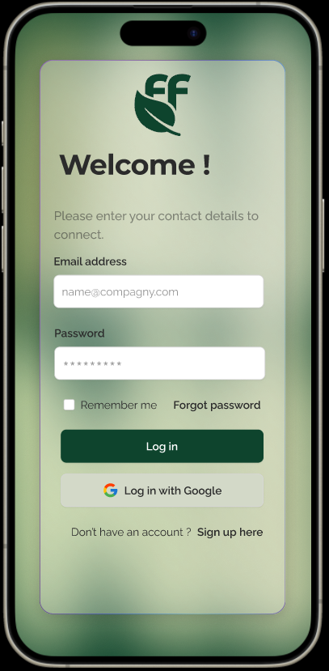
Mobile Application

Slide 15
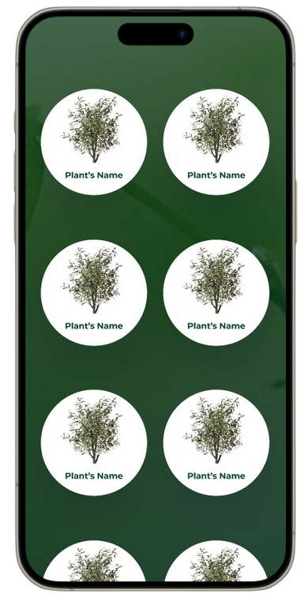
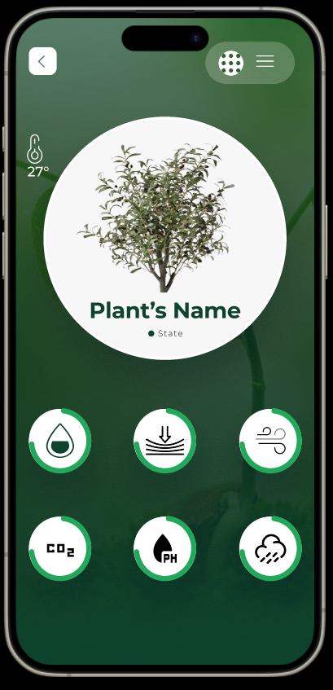
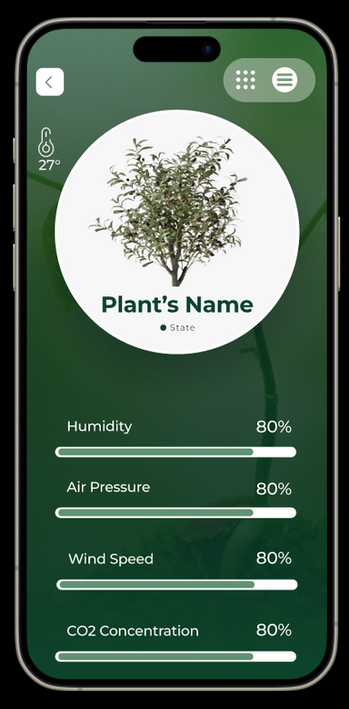
Mobile Application

Slide 16
Thank You

